Slide 1
L.A CRIME REPORT ON SAFER LOS ANGELES INNOVATION
Summary
The "Safer LA Innovation Challenge" this project is designed to inspire entrepreneurs, startups, and organizations to develop innovative solutions to reduce crime in Los Angeles. This innovation aims to foster collaboration between businesses, community leaders, and law enforcement to create safer neighborhoods through technology, services, or community-driven initiatives for businesses.
This report analyses the crime report on Los Angelos on recent crime happening each week, Time and, zones. After going through the data on crime happening in Los Angelos, noticing some crimes are on the rise in some areas and the crime rate is increasing each week which can affect businesses, Officials trying to reduce the rise on property theft and Assault

Slide 2
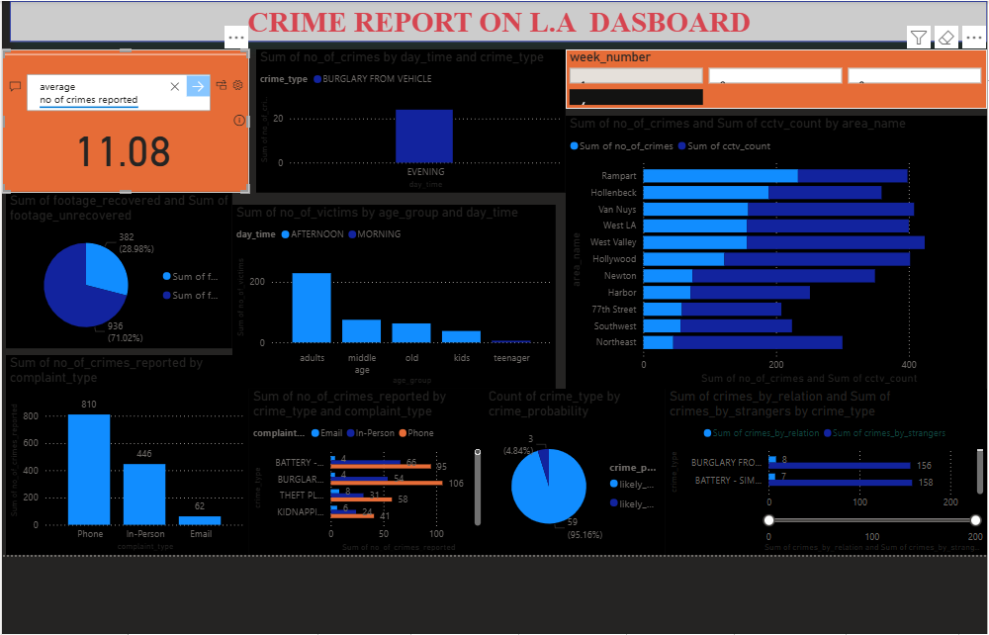

Slide 3
Objectives
i. To support businesses that prioritize social impact alongside profitability in LA.
ii. Reduce crime rates, including violent crime, property crime, and gang-related activities, by 10% in targeted LA neighborhoods to enhance business grow.
iii. Promote community engagement and collaboration with local law enforcement.
Evaluation Criteria
Innovation Creativity and originality of the solution.
Impact Potential to reduce crime and improve community safety.
Feasibility Practicality of implementation within 12-18 months on crime in LA.

Slide 4
Scalability Ability to expand the solution across LA or other cities.
Community Focus Engagement with local residents and stakeholders.
Background on Crime in Los Angeles
Los Angeles has seen fluctuating crime rates, with a reported increase in Battery-Simple Assault and Burglary from Home “crime” according to LAPD data.
High-crime areas include Rampart, Hollenbeck, Van Nuys .
Key issues include gang related activities, home-related crime, and property theft.
Community trust in law enforcement remains a challenge, necessitating solutions that bridge gaps between residents and the LAPD.
Solution
Technology: Adequate CCTV cameras on every street, smart surveillance systems, or mobile apps for community reporting crimes to help business.
Community Programs: Youth mentorship, job training and rehabilitation initiatives to reduce recidivism to crime to reduce theft and stealing on business “small scale business.

Slide 5
Public Safety Services: Private security partnerships, neighborhood watch programs, or conflict mediation services can help reduce crime and help business grow.
Infrastructure Improvements: Better lighting, urban design changes, or safe public spaces at night hours when crime is mostly reported, to reduce midnight and night robbery.
Partnerships
Los Angeles Police Department (LAPD)
LA Mayor’s Office
Local chambers of commerce
CCTV companies and venture capital firms

Slide 6
BUSINESS QUESTIONS
i. Which was the most frequent crime committed each week?
ii. Is crime more prevalent in areas with a higher population density,
fewer police personnel, and a larger precinct area?
iii. At what points of the day is the crime rate at its peak?
Group this by the type of crime.
iv. At what point in the day do more crimes occur in a different locality?
v. Which age group of people is more likely to fall victim
vi. What is the status of reported crimes?.
vii. Does the existence of CCTV cameras deter crimes from happening?
viii. How much footage has been recovered from the CCTV at the crime scene?
ix. Is crime more likely to be committed by relation of victims than strangers?
x. What are the methods used by the public to report a crime?

Slide 7
CONCLUSION
Business can grow and excel in LA, as crime is decreasing and the total area least crime are more than the areas with must crime. If more security agent are deployed to various areas with more crime count, more CCTV should be installed in every street and ally, this will help reduce crime helping businesses to grow in most areas in LA, It is a good idea to invest in LA as with time crime will decrease
This Project is a journey into the heart of ideas that shape our world of data. Written with passion, blood, sweat and precision, it seeks to illuminate complex topics, spark curiosity, and invite reflection. Whether you are an investor or student approaching this project for the first time, my aim is to provide clarity, inspiration, and a fresh perspective in to Safer Los Angeles Innovation (crime in LA), to find solutions and tackle crime in Los Angeles. I hope this work improve your knowledge and enrich your understanding, leaving you eager to explore further. Thank you for embarking on this adventure with me and God Bless You.
E. I. JHN

